Slide 1
Cloud Org
By Russell Powers

Slide 2
Purpose
To province structure to a growing worldwide corporate practice, CFS
To implement an Agile practice(called Cloud Champions) with specific goal of generating agile evangelist to incubate a partner ecosystem of cloud champions with lead the change of culture in are clients.
Automate the CCA
Create Repository of Cloud solutions (Architecture Repository)
Weekly Coaching Seasons
Update artefacts
Update Learning Platform

Slide 3
Capgemini offers a structured, tailor-able approach to define the right cloud journey
CCA
0
Discovery & Mobilizing2
Applications
1
Portfolio Rationalization
Consider Migrate to Cloud
Improve
Value Feasibility
2
Attractive Segments
Technical Feasibility
Med-Hi Feasible
Cloud
Patterns
Retire
Retain
Consolidate
Re-host
Re-mediate
Re-factor
Re-write
Replace
3
Public
Private
IaaS
PaaS
SaaS
4
Business Case, Roadmap & POC Planning
Potential data collection points
Reference: Capgemini CCA

Slide 4
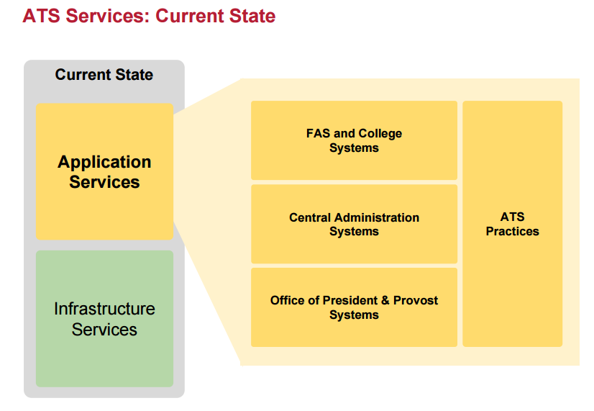
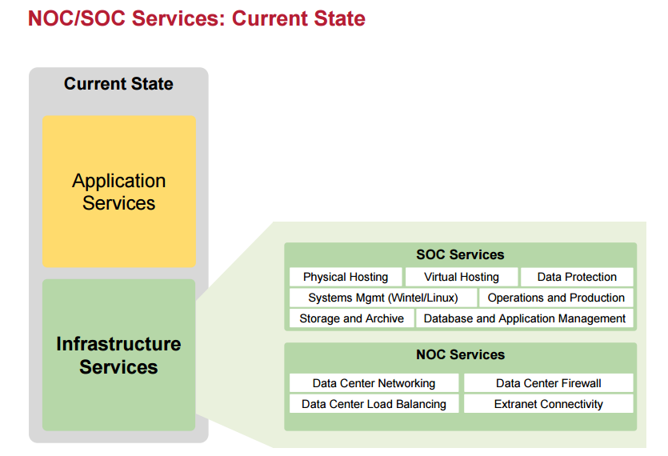
Current-State
Current State
Current State
Application
Services
Application
Services
ASystems Workload1 services()
App Services
practices
S1
S1
S1
ASystems Workload2 services()
IWorkload1 Services()
Infrastructure
Services
S1
S1
S1
Infrastructure
Services
S1
S2
S3
ASystems Workload3 services()
IWorkload2 Services()
S1
S1
S1
S1
S2
S3
Reference: Harvard business School

Slide 5
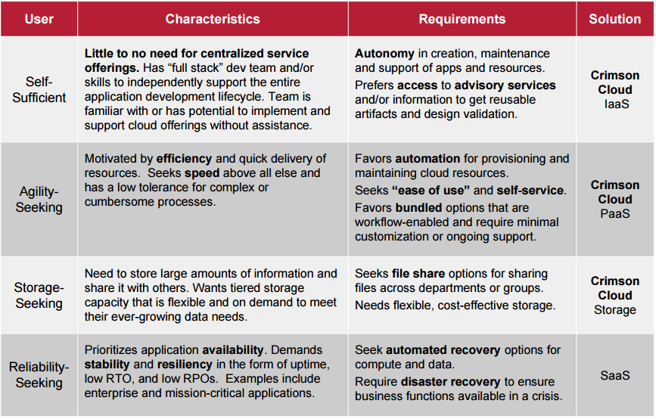
DevOps Team Criteria
1
2
3
4
5
6
7
8
9
10
11
12
13
14
15
16
17
18
19
20
Reference: Harvard business School

Slide 6
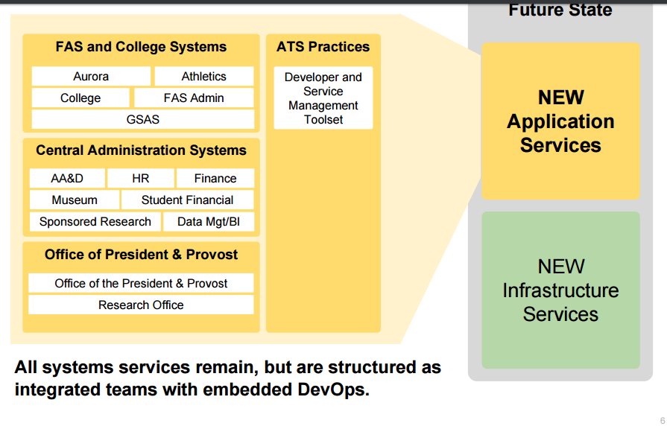
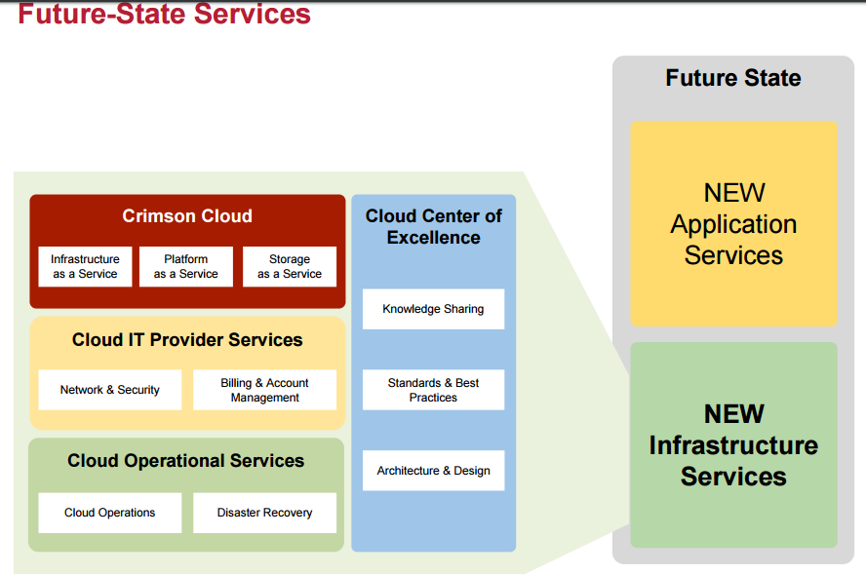
Future-State
Future State
ASystems ()
App Services
Practices
NEW
Application
Services
Future State
s1
s1
s1
s1
s1
s1
NEW
Application
Services
ASystems ()
Clients Cloud()
Cloud Center of Excellence
Central Administration Systemss()
Developer and Service Management Toolset
s1
s1
s1
IaaS
PaaS
SaaS
s1
s1
s1
NEW
Infrastructure
Services
Knowledge Sharing
Cloud IT Provider Services()
ASystems ()
NEW
Infrastructure
Services
Network & Security
Billing & Account Managment
Stardards & Best practices
s1
s1
s1
s1
s1
s1
Cloud Operational Services()
Architecture & Design
Cloud Operations
Disaster Recovery
Reference: Harvard business School

Slide 7
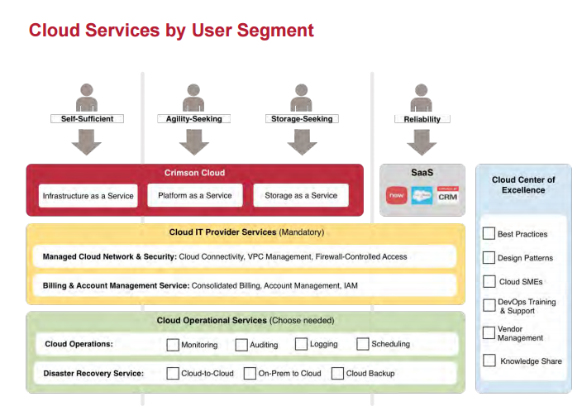
Change Management
1
2
3
4
5
9
10
6
7
8
11
12
13
14
15
16
17
18
19
20
Reference: Harvard business School

Slide 8
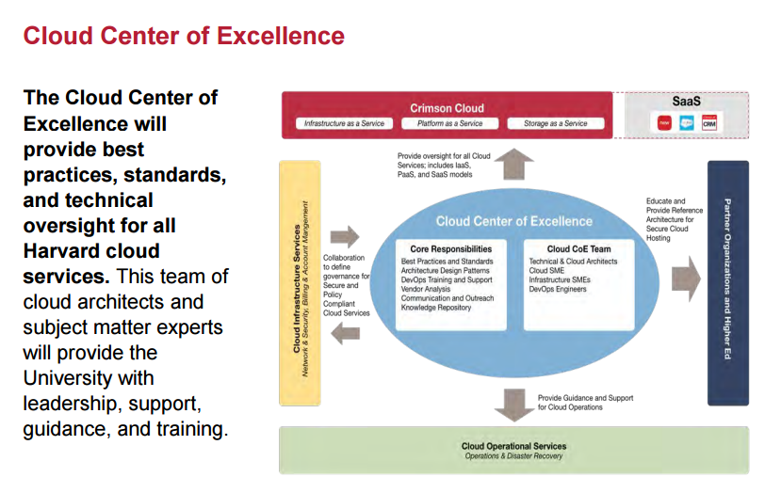
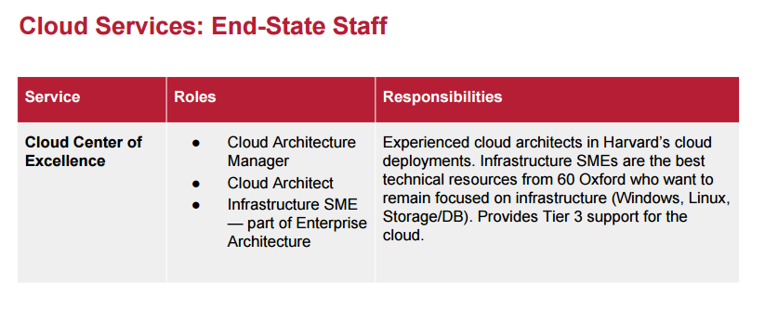
5
9
6
7
8
10
12
13
14
15
1
2
3
4
11
Reference: Harvard business School

Slide 9
Requirements Survey

Slide 10
Storyboard

Slide 11
Decision Diagram

